Slide 1
Data Preprocessing
Raw data is often noisy, inconsistent, and incomplete.
Preprocessing improves data quality and model performance.
Essential step before data analysis or machine learning.
Data preprocessing transforms raw data into a clean and usable format for analysis and machine learning models.
It's a crucial first step that involves cleaning, transforming, integrating, and reducing data to improve quality and efficiency.

Slide 2
Data Preprocessing
The main steps are
Data Cleaning: This step focuses on fixing issues within the data to improve its quality. Think of it as tidying up your dataset.
Data Transformation: This step involves modifying the data's structure or format to make it more suitable for machine learning algorithms.
Data Reduction: This step aims to reduce the size of the dataset without sacrificing important information, making the analysis faster and more efficient.

Slide 3
Data Preprocessing
Handling Missing Values
Data Cleaning
Correcting Inaccurate or Inconsistent Data
Handling Outliers and Noise
Normalization and Standardization
Data Transformation
Encoding Categorical Data
Feature Engineering
Dimensionality Reduction
Data Reduction
Numerosity Reduction

Slide 4
Data Preprocessing : Data Cleaning
Handling Missing Values
Handling missing values is a crucial data cleaning step because most machine learning algorithms cannot work with empty or null data points.
Choosing the right method depends on the nature of the data and the amount of missing information.
Let's use a simple example dataset to discuss the common techniques.

Slide 5
Data Preprocessing : Data Cleaning
Handling Missing Values
Example Dataset: Employee Info
Imagine we have the following data about employees. The NaN values represent missing data.
Employee ID | Age | Experience (Years) | Salary
101 | 25 | 2 | 50,000
102 | 30 | NaN | 65,000
103 | 45 | 20 | 120,000
104 | 28 | 5 | NaN
105 | 50 | 25 | 140,000

Slide 6
Data Preprocessing : Data Cleaning
Handling Missing Values
1. Deletion Methods
The simplest approach is to just remove the missing data.
Listwise Deletion: This involves deleting the entire row that contains a missing value. In our example, we would remove the rows for Employee ID 102 and 104.
Employee ID | Age | Experience (Years) | Salary
101 | 25 | 2 | 50,000
102 | 30 | NaN | 65,000
103 | 45 | 20 | 120,000
104 | 28 | 5 | NaN
105 | 50 | 25 | 140,000
Employee ID | Age | Experience (Years) | Salary
101 | 25 | 2 | 50,000
103 | 45 | 20 | 120,000
105 | 50 | 25 | 140,000

Slide 7
Data Preprocessing : Data Cleaning
Handling Missing Values
1. Deletion Methods
Pros: Easy and fast.
Cons:
You lose a lot of data, which can lead to a biased model if the missing values aren't random.
This is only recommended if you have a very large dataset and only a few rows with missing values.
Employee ID | Age | Experience (Years) | Salary
101 | 25 | 2 | 50,000
102 | 30 | NaN | 65,000
103 | 45 | 20 | 120,000
104 | 28 | 5 | NaN
105 | 50 | 25 | 140,000
Employee ID | Age | Experience (Years) | Salary
101 | 25 | 2 | 50,000
103 | 45 | 20 | 120,000
105 | 50 | 25 | 140,000

Slide 8
Data Preprocessing : Data Cleaning
Handling Missing Values
2. Imputation with a Single Value
Imputation means filling in the missing values. The most common way is to use a statistical measure from the column.
Mean/Median Imputation: You can replace missing numerical data with the mean (average) or median (middle value) of the column. The median is often preferred because it's less sensitive to outliers.
Mode Imputation: For categorical data (e.g., a 'Department' column), you'd use the mode (the most frequent value).
Let's apply this to our original dataset.

Slide 9
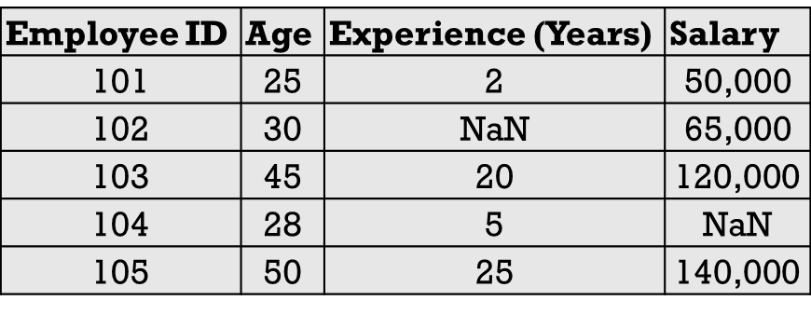
Data Preprocessing : Data Cleaning
Handling Missing Values
2. Imputation with a Single Value
Step 1: Calculate the mean for 'Experience' and 'Salary'.
Known 'Experience' values: 2, 20, 5, 25.
Mean Experience = (2+20+5+25)/4=13 years.
Known 'Salary' values: 50000, 65000, 120000, 140000.
Mean Salary = 50000+65000+120000+140000)/4=93,750.

Slide 10
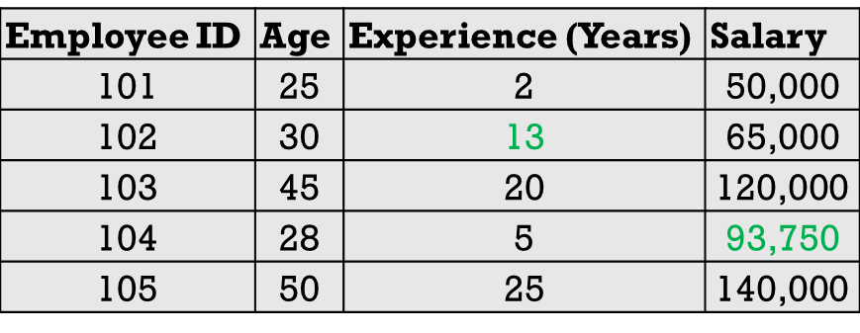
Data Preprocessing : Data Cleaning
Handling Missing Values
2. Imputation with a Single Value
Step 2: Fill in the NaN values.
The missing 'Experience' for employee 102 becomes 13.
The missing 'Salary' for employee 104 becomes 93,750.
Pros:
Simple to implement and retains all data rows.
Cons:
Can reduce the natural variance in the data and weaken the relationships between variables, as it doesn't account for correlations.
For instance, a 28-year-old is now assigned the average salary, which might not be realistic.

Slide 11
Data Preprocessing : Data Cleaning
Handling Missing Values
3. Advanced Imputation Method
More sophisticated techniques use other features to predict the missing values.
Regression Imputation: This method builds a regression model to predict the missing value. For example, we could create a model to predict 'Salary' based on 'Age' and 'Experience'. We would train this model on the complete rows (101, 103, 105) and then use it to predict the salary for employee 104.
K-Nearest Neighbors (KNN) Imputation: This method finds the 'k' most similar data points (neighbors) to the one with the missing value and then imputes the missing value based on the average of its neighbors.
Pros: Usually more accurate than simple imputation and better at preserving relationships between variables.
Cons: Much more complex to implement and computationally expensive.

Slide 12
Data Preprocessing
Handling Missing Values
Data Cleaning
Correcting Inaccurate or Inconsistent Data
Handling Outliers and Noise
Normalization and Standardization
Data Transformation
Encoding Categorical Data
Feature Engineering
Dimensionality Reduction
Data Reduction
Numerosity Reduction

Slide 13
Data Preprocessing : Data Cleaning
Correcting Inaccurate or Inconsistent Data
Correcting inaccurate or inconsistent data is the process of identifying and fixing errors, contradictions, and structural issues to ensure your dataset is reliable and uniform.
Think of it as proofreading your data to make sure every entry is accurate and follows the same set of rules.
This process is vital because inconsistencies can lead to incorrect analysis, biased models, and flawed conclusions.
Next is how to do it, broken down by common types of errors.

Slide 14
Data Preprocessing : Data Cleaning
Correcting Inaccurate or Inconsistent Data
1. Correcting Inconsistent Categorical Data
This happens when the same category is represented in multiple ways.
The Problem: A 'Country' column might contain "USA," "U.S.A.," "United States," and "America." A data analysis tool would treat these as four different countries.
How to Fix It (Standardization):
Explore Unique Values: First, identify all the unique entries in the column
Define a Standard: Decide on a single, standard representation.
Create a Mapping: Create a dictionary to map the variations to your chosen standard. Use the map to replace the inconsistent values.

Slide 15
Data Preprocessing : Data Cleaning
Correcting Inaccurate or Inconsistent Data
2. Fixing Structural Errors
These are typos, unwanted characters, or inconsistent capitalization that affect data quality.
The Problem: A 'Name' column might have entries like " John Smith ", "john smith", or "John_Smith".
How to Fix It (Cleaning and Formatting):
Trim Whitespace: Remove any leading or trailing spaces. Most programming languages have a trim() or strip() function.
Standardize Case: Convert all text to a single case (usually lowercase) to ensure consistency. Use a lower() function.
Remove Unwanted Characters: Use a replace() function to remove special characters like underscores or dashes if they don't belong.

Slide 16
Data Preprocessing : Data Cleaning
Correcting Inaccurate or Inconsistent Data
3. Resolving Logical Errors and Contradictions
This involves finding data points that are logically impossible or contradict other information in the dataset.
The Problem:
A person's Date of Death is earlier than their Date of Birth.
An 'Age' column shows 15, but the 'Employment Status' column says Full-Time Employee.
An Order_Date is later than the Shipping_Date.

Slide 17
Data Preprocessing : Data Cleaning
Correcting Inaccurate or Inconsistent Data
3. Resolving Logical Errors and Contradictions
How to Fix It (Validation Rules):
Define Rules: Establish logical rules that your data must follow (e.g., Age must be greater than 18 for Employment Status == 'Full-Time Employee').
Flag Violations: Write a script to check each row against your rules and flag the ones that fail.
Correct Manually or Programmatically: For some errors, you might need to investigate the original source to find the correct data. For others, you might set the problematic entry to NaN (missing) and handle it later. If a Date of Birth is "1992" and Age is "20", you could write a rule to recalculate the age based on the current date.

Slide 18
Data Preprocessing : Data Cleaning
Correcting Inaccurate or Inconsistent Data
4. Standardizing Units and Formats
This ensures all numerical data and dates are comparable.
The Problem:
A 'Weight' column contains values in both pounds (lbs) and kilograms (kg).
A 'Date' column has multiple formats like "07-25-2025," "25/Jul/2025.
How to Fix It (Conversion and Parsing):
For Numerical Units: Identify the different units present. Choose a standard unit (e.g., kg) and apply a conversion formula to all non-standard entries (e.g., weight_in_kg = weight_in_lbs * 0.453592).
For Dates: Use a robust date-parsing function to automatically recognize and convert all date formats into a single, standard format, like YYYY-MM-DD.

Slide 19
Data Preprocessing
Handling Missing Values
Data Cleaning
Correcting Inaccurate or Inconsistent Data
Handling Outliers and Noise
Normalization and Standardization
Data Transformation
Encoding Categorical Data
Feature Engineering
Dimensionality Reduction
Data Reduction
Numerosity Reduction

Slide 20
Data Preprocessing : Data Cleaning
Handling Outliers and Noise
Handling outliers and noise is a critical data cleaning step to prevent skewed results and improve model accuracy. While related, they are different:
Outliers are legitimate data points that are unusually far from the rest of the data. Think of the net worth of a billionaire in a sample of regular citizens.
Noise is random error or variance in the data, like a slight fluctuation in a sensor reading.

Slide 21
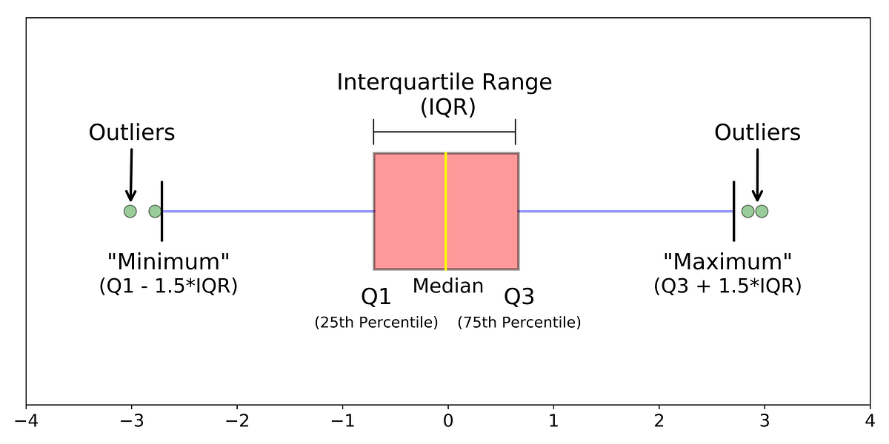
Data Preprocessing : Data Cleaning
Handling Outliers
The first step is to find the outliers, and then you can decide what to do with them.
Step 1: Detecting Outliers
1. Visual Method (Box Plots):
This is the easiest way to "see" outliers. A box plot visualizes the distribution of data. Any data point that falls outside the "whiskers" of the plot is typically considered an outlier.

Slide 22
Data Preprocessing : Data Cleaning
Handling Outliers
2. Statistical Method (Interquartile Range - IQR):
The IQR method provides a numerical way to identify outliers.
Calculate the first quartile (Q1, the 25th percentile) and the third quartile (Q3, the 75th percentile).
Calculate the IQR: IQR=Q3−Q1.
Define the outlier boundaries. A data point is considered an outlier if it falls below Q1−1.5 times IQR or above Q3+1.5 times IQR.
3. Z-Score Method:
The Z-score tells you how many standard deviations a data point is from the mean. A common rule of thumb is that any point with a Z-score greater than 3 or less than -3 is an outlier.

Slide 23
Data Preprocessing : Data Cleaning
Handling Noise
Handling noise involves using "smoothing" techniques to remove random fluctuations and reveal the underlying trend.
1. Binning:
This method groups a range of continuous values into "bins" or intervals. After creating the bins, you can smooth the data by replacing every value in a bin with the bin's mean, median, or boundary value.
Example: Imagine the sorted price data: [3, 5, 8, 15, 16, 17, 25, 26, 30].
You could create 3 bins: [3, 5, 8], [15, 16, 17], and [25, 26, 30].
If you smooth by the mean, the data becomes [5.3, 5.3, 5.3], [16, 16, 16], and [27, 27, 27].

Slide 24
Data Preprocessing : Data Cleaning
Handling Noise
2. Regression:
You can fit a regression line (or curve) to the data. The data points on this line are considered the "smoothed," noise-free values. The original data points are then replaced with their corresponding values on the regression line.
3. Moving Averages:
This is very common for time-series data (like stock prices or temperature readings). It smooths the data by calculating the average of a "sliding window" of a fixed size. For example, a 7-day moving average would replace each day's value with the average of that day, the 3 previous days, and the 3 following days. This smooths out daily fluctuations and highlights the longer-term trend.

Slide 25
Data Preprocessing
Handling Missing Values
Data Cleaning
Correcting Inaccurate or Inconsistent Data
Handling Outliers and Noise
Normalization and Standardization
Data Transformation
Encoding Categorical Data
Feature Engineering
Dimensionality Reduction
Data Reduction
Numerosity Reduction

Slide 26
Data Preprocessing : Data Transformation
Normalization and Standardization
Normalization and Standardization are two essential data transformation techniques used to scale numerical features to a common level, but they do so in different ways.
Let's use a simple dataset to illustrate both. Imagine we have data for a small group of people and we want to scale the 'Income' feature.
Person | Age | Income
A | 25 | 50,000
B | 30 | 65,000
C | 45 | 120,000
D | 50 | 140,000
E | 35 | 95,000

Slide 27
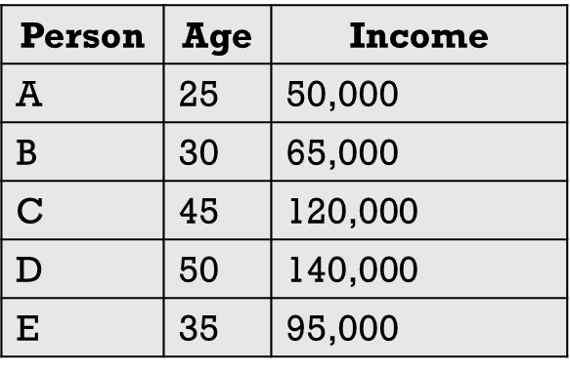
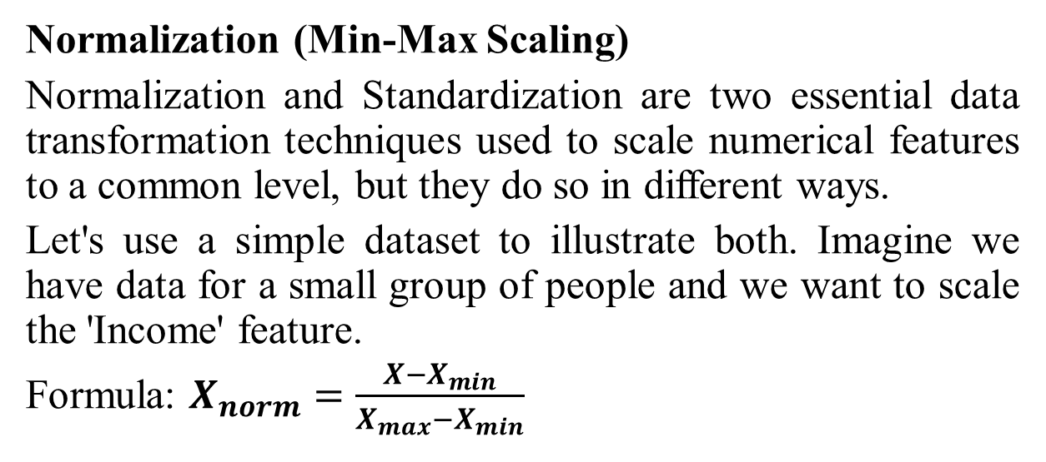
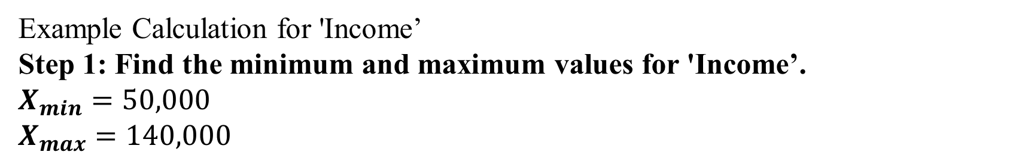
Data Preprocessing : Data Transformation
Normalization (Min-Max Scaling)
Normalization and Standardization are two essential data transformation techniques used to scale numerical features to a common level, but they do so in different ways.
Let's use a simple dataset to illustrate both. Imagine we have data for a small group of people and we want to scale the 'Income' feature.
Formula: $X_{norm}=\frac{X−X_{min}}{X_{max}−X_{min}}$
Example Calculation for 'Income’
Step 1: Find the minimum and maximum values for 'Income’.
$X_{min}=50,000$​
$$X_{max}=140,000$$

Slide 28
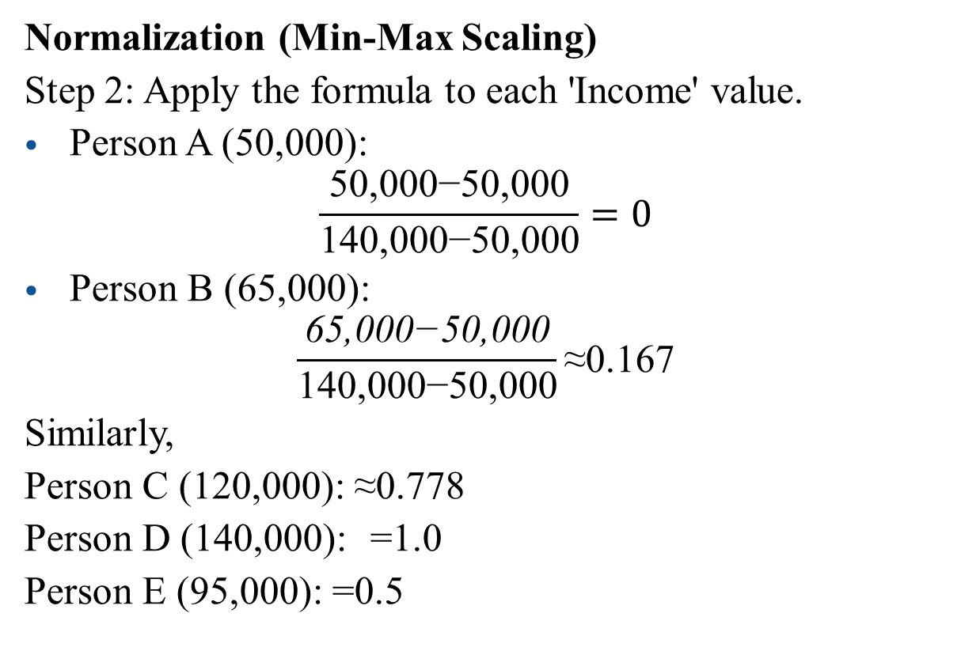
Data Preprocessing : Data Transformation
Normalization (Min-Max Scaling)
Step 2: Apply the formula to each 'Income' value.
Person A (50,000):
$$\frac{\text{50,000−50,000}}{\text{140,000−50,000}}=0$$
Person B (65,000):
$$\frac{\text{65,000−50,000}}{\text{140,000−50,000}}\text{≈0.167}$$
Similarly,
Person C (120,000): ≈0.778
Person D (140,000): =1.0
Person E (95,000): =0.5
Person | Age | Income
A | 25 | 0
B | 30 | 0.167
C | 45 | 0.778
D | 50 | 1.0
E | 35 | 0.5

Slide 29
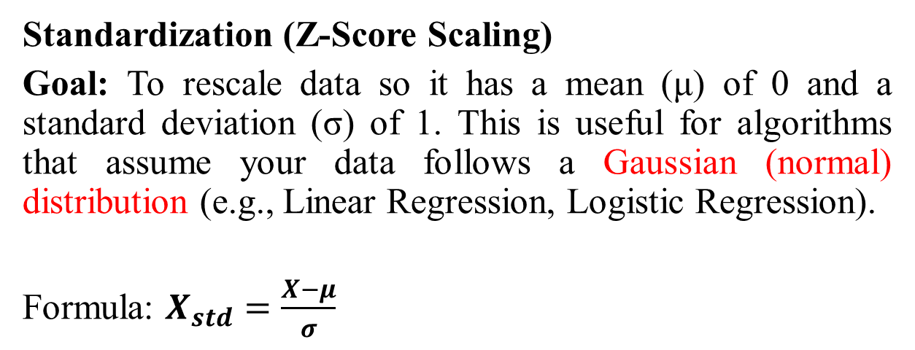
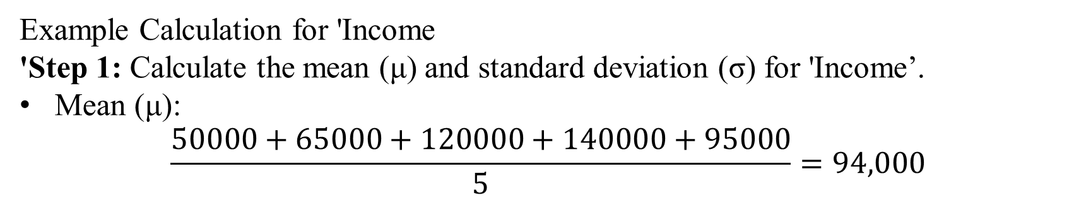
Data Preprocessing : Data Transformation
Standardization (Z-Score Scaling)
Goal: To rescale data so it has a mean (μ) of 0 and a standard deviation (σ) of 1. This is useful for algorithms that assume your data follows a Gaussian (normal) distribution (e.g., Linear Regression, Logistic Regression).
Formula: $X_{std}=\frac{X−μ}{σ}$
Example Calculation for 'Income
'Step 1: Calculate the mean (μ) and standard deviation (σ) for 'Income’.
Mean (μ):
$$\frac{50000+65000+120000+140000+95000​}{5}=94,000$$

Slide 30
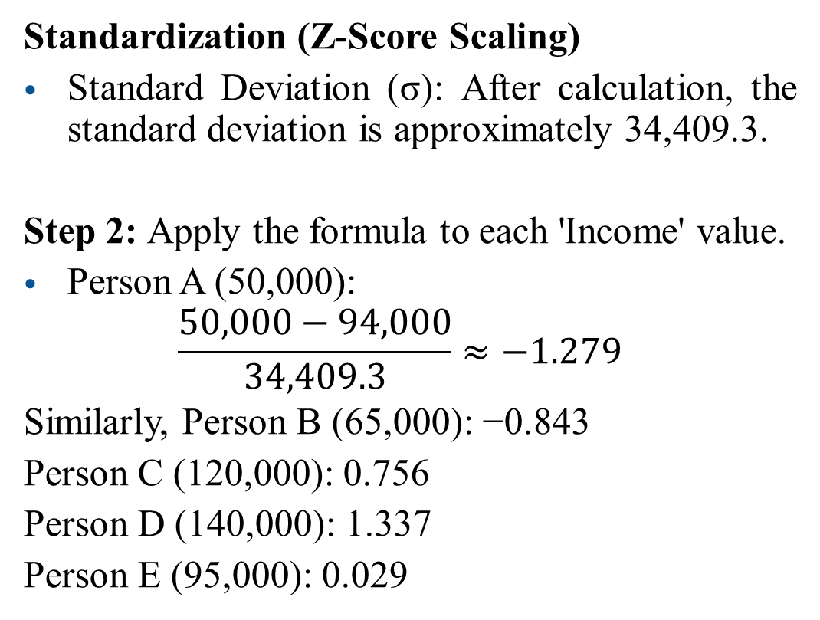
Data Preprocessing : Data Transformation
Standardization (Z-Score Scaling)
Standard Deviation (σ): After calculation, the standard deviation is approximately 34,409.3.
Step 2: Apply the formula to each 'Income' value.
Person A (50,000):
$$\frac{50,000−94,000}{34,409.3}≈−1.279$$
Similarly, Person B (65,000): −0.843
Person C (120,000): 0.756
Person D (140,000): 1.337
Person E (95,000): 0.029
Person | Original Income | Normalized Income | Standardized Income
A | 50,000 | 0.000 | -1.279
B | 65,000 | 0.167 | -0.843
C | 120,000 | 0.778 | 0.756
D | 140,000 | 1.000 | 1.337
E | 95,000 | 0.500 | 0.029

Slide 31
Data Preprocessing
Handling Missing Values
Data Cleaning
Correcting Inaccurate or Inconsistent Data
Handling Outliers and Noise
Normalization and Standardization
Data Transformation
Encoding Categorical Data
Feature Engineering
Dimensionality Reduction
Data Reduction
Numerosity Reduction

Slide 32
Data Preprocessing : Data Transformation
Encoding Categorical Data
Encoding categorical data is the process of converting text-based categories into numbers so that machine learning algorithms can process them.
Let's use a simple example. Imagine you have survey data with a "Favorite Fruit" column.
A machine learning model can't understand "Apple" or "Orange." We need to encode these labels into numbers. Here are the two most common ways to do that.
Person ID | Favorite Fruit
1 | Apple
2 | Orange
3 | Banana
4 | Apple
5 | Banana

Slide 33
Data Preprocessing : Data Transformation
Person ID | Favorite Fruit
1 | Apple
2 | Orange
3 | Banana
4 | Apple
5 | Banana
1. Label Encoding
Important Note:
Be careful using this for non-ordered (nominal) data.
Label Encoding creates an artificial order (Banana (2) > Orange (1)), which can mislead some models into thinking there's a ranking when there isn't one.
Person ID | Favorite Fruit | Favorite Fruit (Encoded)
1 | Apple | 0
2 | Orange | 1
3 | Banana | 2
4 | Apple | 0
5 | Banana | 2

Slide 34
Data Preprocessing : Data Transformation
2. One-Hot Encoding
This is the preferred method for nominal data (categories without a natural order). It creates a new binary (0 or 1) column for each unique category.
Person ID | Favorite Fruit
1 | Apple
2 | Orange
3 | Banana
4 | Apple
5 | Banana
How it works:
Identify all unique categories: "Apple," "Orange," "Banana.“
Create a new column for each category.
For each row, place a 1 in the column corresponding to its category and 0s in all other new columns.
Person ID | Favorite Fruit | Apple | Orange | Banana
1 | Apple | 1 | 0 | 0
2 | Orange | 0 | 1 | 0
3 | Banana | 0 | 0 | 1
4 | Apple | 1 | 0 | 0
5 | Banana | 0 | 0 | 1

Slide 35
Data Preprocessing : Data Transformation
2. One-Hot Encoding
This method effectively represents the categories without creating any false relationships between them, making it a safer and often more effective choice for most machine learning tasks.
Person ID | Favorite Fruit
1 | Apple
2 | Orange
3 | Banana
4 | Apple
5 | Banana
Person ID | Favorite Fruit | Apple | Orange | Banana
1 | Apple | 1 | 0 | 0
2 | Orange | 0 | 1 | 0
3 | Banana | 0 | 0 | 1
4 | Apple | 1 | 0 | 0
5 | Banana | 0 | 0 | 1

Slide 36
Data Preprocessing
Handling Missing Values
Data Cleaning
Correcting Inaccurate or Inconsistent Data
Handling Outliers and Noise
Normalization and Standardization
Data Transformation
Encoding Categorical Data
Feature Engineering
Dimensionality Reduction
Data Reduction
Numerosity Reduction

Slide 37
Data Preprocessing : Data Transformation
Raw Dataset Columns:
area_sqft
num_bedrooms
num_bathrooms
build_year
Location
price
Feature Engineering
Feature Engineering Steps
1. Creating Interaction Features
Problem: The impact of area_sqft on price may depend on location.
Solution: Create a new feature: price_per_sqft
Why?
Captures value density (e.g., 1000 sqft in downtown vs. suburbs).
More informative than raw area_sqft or price alone

Slide 38
Data Preprocessing : Data Transformation
Raw Dataset Columns:
area_sqft
num_bedrooms
num_bathrooms
build_year
Location
price
Feature Engineering
Feature Engineering Steps
2. Binning Numerical Features
Problem: build_year (e.g., 1920, 1995, 2010) has a non-linear relationship with price.
Solution: Bin into categories
Why?
Simplifies complex trends (e.g., "new" homes may sell at a premium).
Reduces noise in old year values.

Slide 39
Data Preprocessing : Data Transformation
Raw Dataset Columns:
area_sqft
num_bedrooms
num_bathrooms
build_year
Location
price
Feature Engineering
Feature Engineering Steps
3. Polynomial Features
Problem: The relationship between num_bedrooms and price may be quadratic (e.g., 4 bedrooms are optimal, not 10).
Solution: Add quared term
Why?
Captures non-linear effects missed by linear models.

Slide 40
Data Preprocessing : Data Transformation
Raw Dataset Columns:
area_sqft
num_bedrooms
num_bathrooms
build_year
Location
price
Feature Engineering
Feature Engineering Steps
4. Domain-Specific Features
Problem: Raw location (e.g., "Main St") lacks granularity.
Solution: Engineer:
proximity_to_center (distance in km to city center)
has_good_school (binary: 1 if near top-rated school)
Why?
Encodes real-world knowledge (schools/center impact prices).

Slide 41
Data Preprocessing : Data Transformation
Raw Dataset Columns:
area_sqft
num_bedrooms
num_bathrooms
build_year
Location
price
Feature Engineering
Feature Engineering Steps
5. Temporal Features
Problem: build_year as integer ignores depreciation trends.
Solution: Create house_age
Why?
Age often matters more than build year (e.g., a 5-year-old vs. 50-year-old house).

Slide 42
Data Preprocessing : Data Transformation
Raw Dataset Columns:
area_sqft
num_bedrooms
num_bathrooms
build_year
Location
price
Feature Engineering
Original Features | Engineered Features
area_sqft | price_per_sqft
num_bedrooms | bedrooms_squared
build_year | age_group, house_age
location | proximity_to_center, has_good_school

Slide 43
Data Preprocessing
Handling Missing Values
Data Cleaning
Correcting Inaccurate or Inconsistent Data
Handling Outliers and Noise
Normalization and Standardization
Data Transformation
Encoding Categorical Data
Feature Engineering
Dimensionality Reduction
Data Reduction
Numerosity Reduction

Slide 44
Data Preprocessing : Data Reduction
Dimensionality Reduction: This reduces the number of features (columns). High-dimensional data can lead to poor model performance (the "curse of dimensionality").
Techniques like Principal Component Analysis (PCA) create a smaller set of new features that capture most of the original data's variance.
Another method is feature selection, where you simply choose the most relevant features and discard the rest.
Numerosity Reduction: This reduces the number of data entries (rows). When dealing with massive datasets, you can use sampling (selecting a representative subset of the data) or use models like clustering or regression to represent the data more compactly.

Slide 45
Data Preprocessing : Data Reduction
Details of PCA, Feature Selection, Clustering will be taught later classes

